Slide 1
UI Design Document
Team name: Graduos
Project name: 졸업해줘
Date of doc: 2024/12/09
Version: Final
Team Members
권준호 (2019920003)
김원빈 (2019920016)
정민혁 (2019920048)
채민관 (2019920055)
박정익 (2020920025)
이현제 (2020920051)

Slide 2
UI Design Document
- Table of Contents -
1. Screenshot: Login UI
2. Screenshot: Dashboard UI
3. Sketch: Design Concept

Slide 3
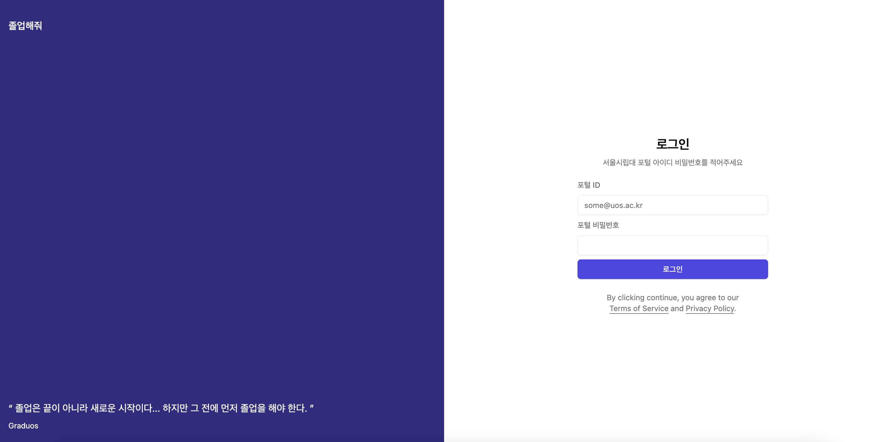
1. Screenshot: Login UI

Slide 4
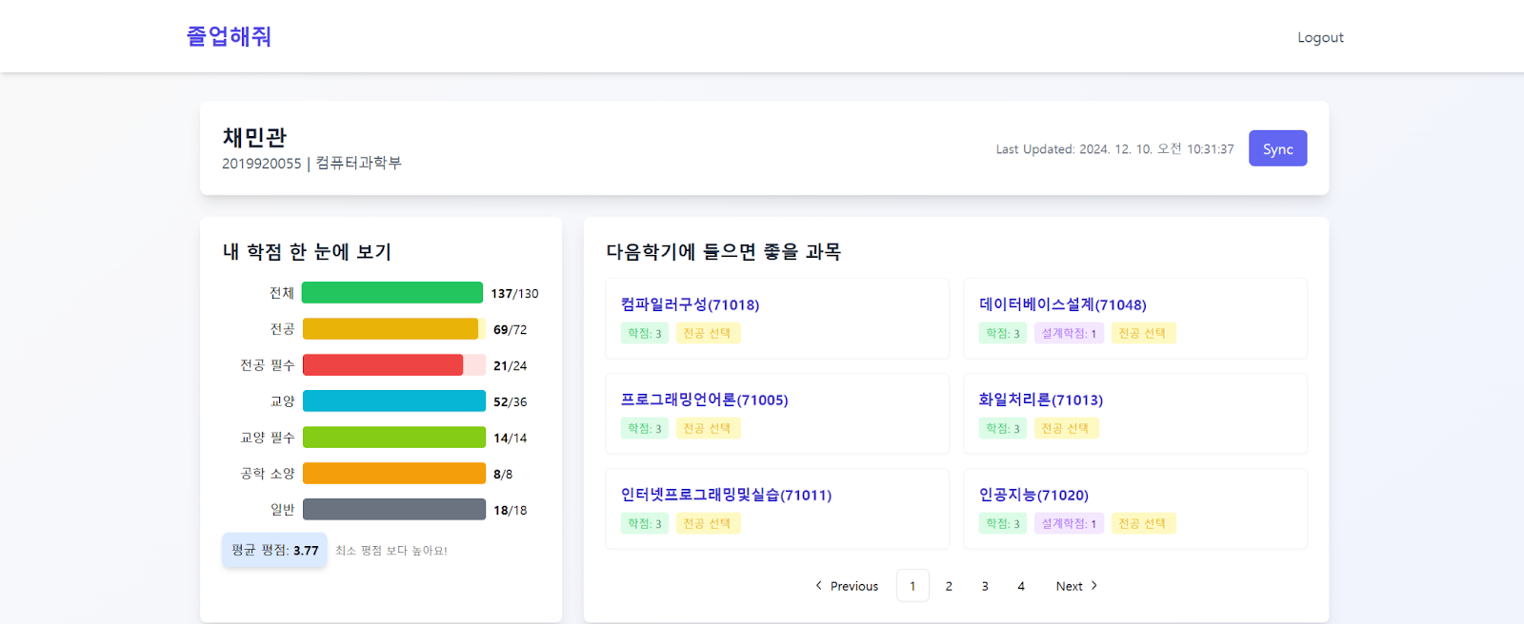
2. Screenshot: User’s Dashboard UI

Slide 5
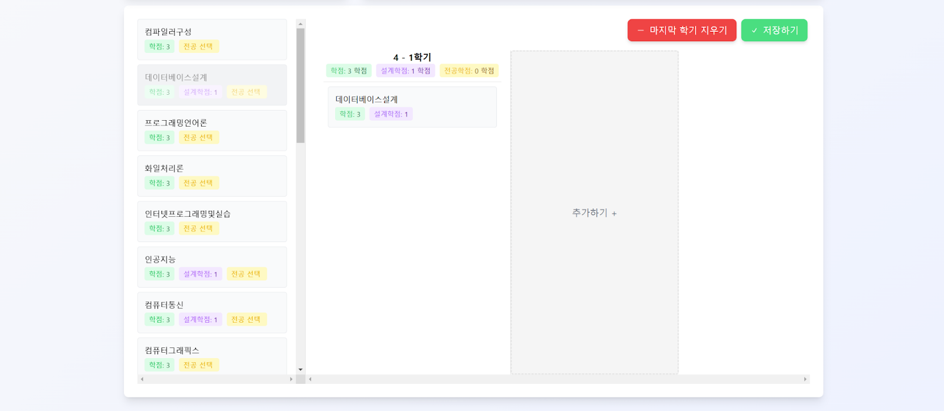
2. Screenshot: User’s Dashboard UI

Slide 6
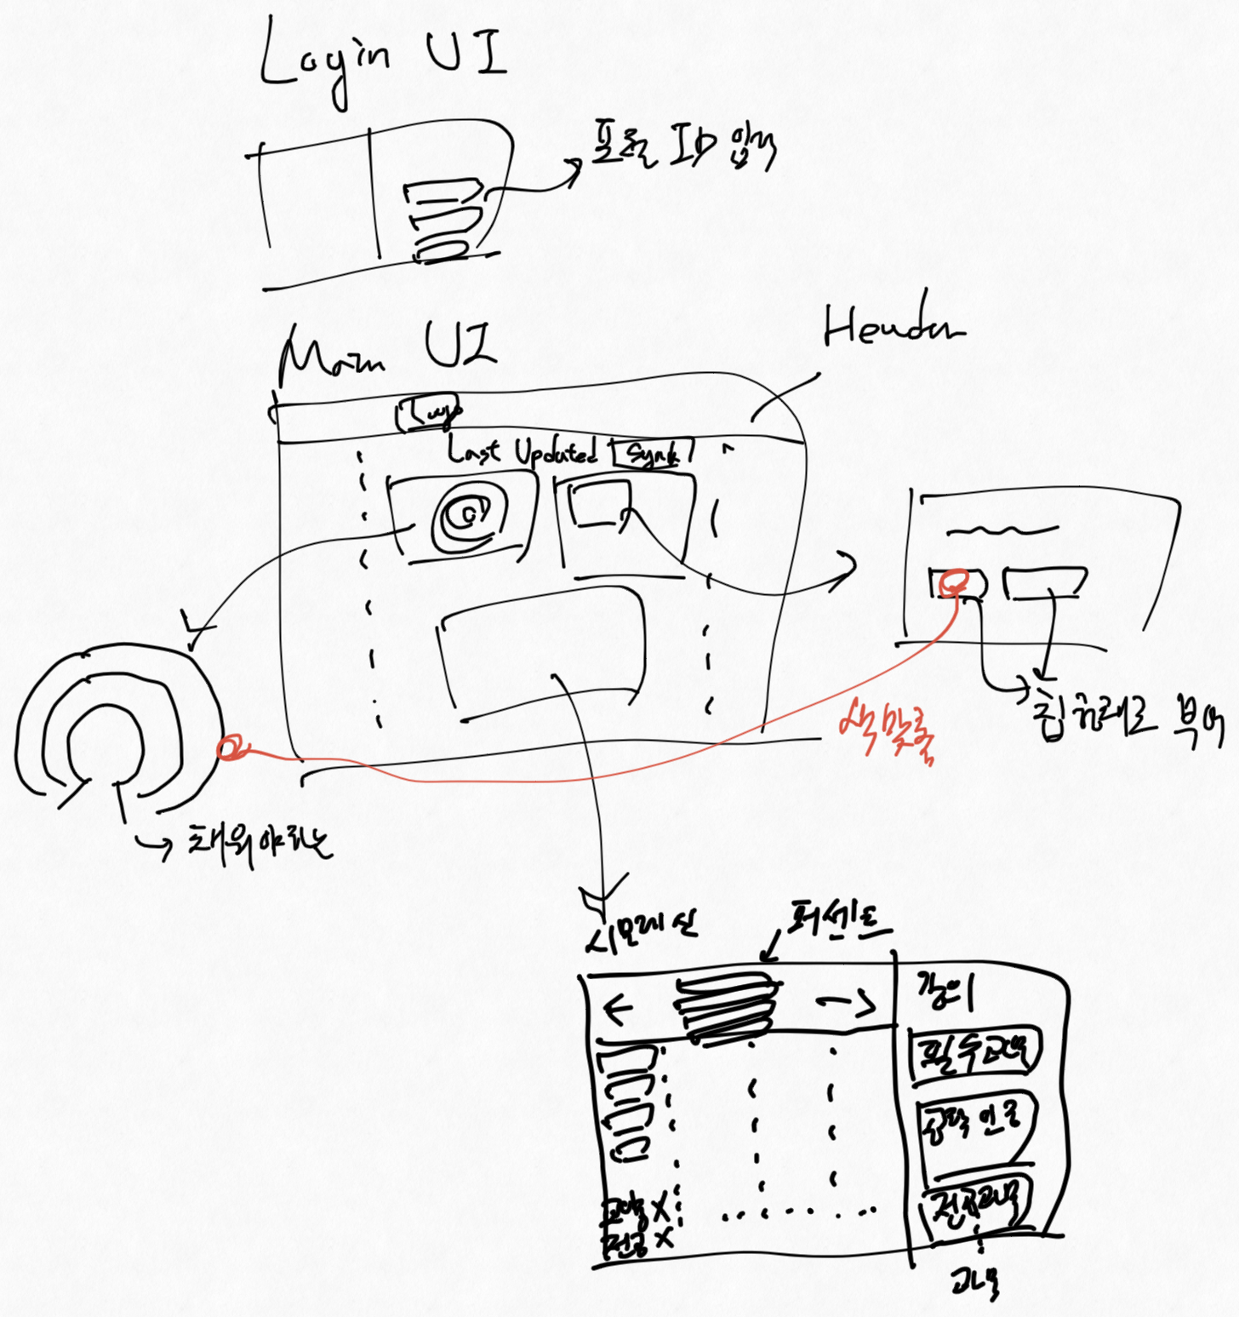
3. Sketch: Design Concept

